Slide 1
Before the session
There will be code along during this session. I will be using Python, NumPy, Pandas. Scikit-Learn, and Matplotlib. If you want to code with me, please install them (if you don’t have them). If you have Anaconda installed, you should be fine. But you don’t need to code if you don’t want to.
All the code will be available at:
https://github.com/superleesa/tech_pod/tree/main/linear_regression
download “diabetes_single_feature.csv” from this repo

Slide 2
Linear Regression and a Method for Creating a Supervised ML Algorithm from Scratch

Slide 3
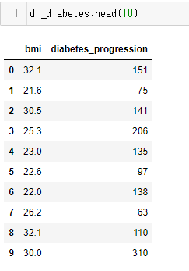
Let’s say we are helping doctors and want to predict patients’ diabetes progression…
https://archive.ics.uci.edu/ml/datasets/diabetes
Feature
- bmi body mass index
Label
- disease progression indicator one year after

Slide 4
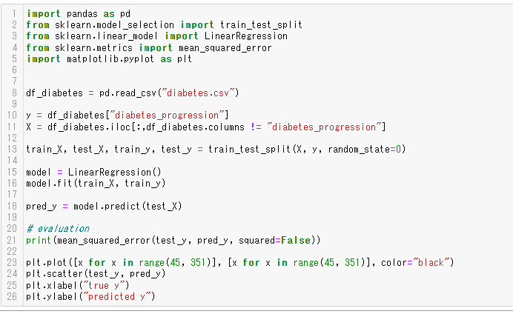
We can use LinearRegression from scikit-learn
We’ll code this together later on

Slide 5
But pretend that you don’t know anything about libraries or even ML concepts. How will you predict a patient’s diabetes progression in the future?
We have data from the past – that shows the relationship between the patients’ status and the diabetes progression.
We want to somehow use this data
IDEA: If we can determine the relationship between x and y from this past data, such as:
y is small when x is big (e.g. diabetes progression is small when a patient is younger)
y increases rapidly when x is bigger
y is twice as big as x (diabetes progresses is twice faster when a patient has larger BMI)
→ when another X (a patient’s status) is found, the relationship can inform the corresponding value of y (diabetes progression after a year).

Slide 6
And that’s exactly what ML is trying to do
y: diabetes progression
281
27
x: BMI
Fit a line (model) to data = finding relationship
Predict = using relationship
e.g. Given BMI = 27, the model can predict the diabetes progression level is 27*10.4 = 281.
e.g. as age triples, the diabetes progression level doubles.
(coef = 10.4)
Notes:
There are two stages in supervised machine learning.
to an existing data that shows the relationship between feature/s (patients’ status) and label (patients’ feature diabetes progression)

Slide 7
Code Along: Let’s make a regression model and predict

Slide 8
But then how do these algorithms work? How do these algorithms use the past data to make a model and predict?
Today, I want to go through the process of “creating” a machine learning algorithm, using linear regression as an example.
To simplify things, we will first only use the “bmi” column as a feature.
This kind of regression, where only one feature is used, is called Simple Linear Regression (SLR).
(Next week we might use all features to predict the diabetes progression level.)

Slide 9
General Steps to create a ML algorithm
Prepare a Base Model
Define Cost(Objective) Function
Solve Mathematical Optimization Problem
Implement it

Slide 10
Model Preparation

Slide 11
Question: what kind of function should these data points be fitted by?
Relationship A
Relationship B
A = line, B = second-order polynomial (quadratic function)
A= line, B = trigonometric function
A = log, B = trigonometric function
A = log, B = second-order polynomial

Slide 12
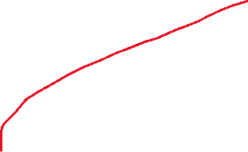
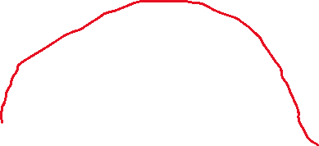
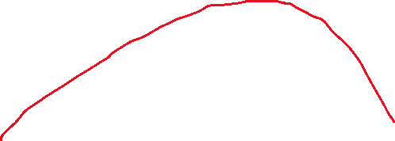
Question: what kind of function should these data points be fitted by?
Relationship A
Relationship B
f(x) = x
f(x) = log(x)
f(x) = sin(x)
f(x) = x^2
A = line, B = second-order polynomial (quadratic function)
A= line, B = trigonometric function
A = log, B = trigonometric function
A = log, B = second-order polynomial
All of them might be correct

Slide 13




Pick a Base Model with Suitable Complexity
One Line (e.g. linear regression)
One Polynomials/Custom Function (e.g. polynomial regression)
Many lines, parallel to axes (e.g. decision tree)
For today, we choose a line as a model for simplicity
Many lines/polynomials (e.g. neural network)
Complex
More likely to overfit = high variance
Simple
More likely to underfit = high bias
Suitable for simpler tabular data
Suitable for complex tabular data
Suitable for complex data (e.g. image/audio)

Slide 14
Defining Loss/Cost Function

Slide 15
General Steps to create a ML algorithm
Prepare a Base Model
Define Cost(Objective) Function
Solve Mathematical Optimization Problem
Implement it

Slide 16
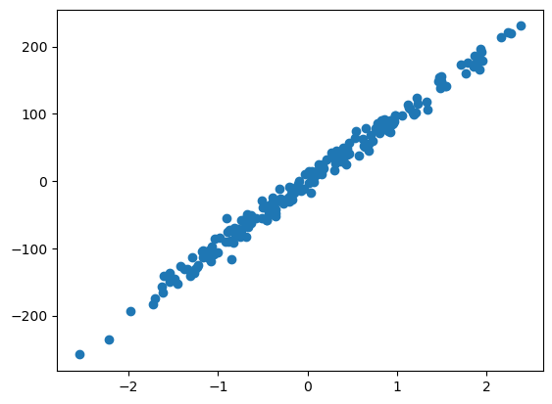
What is cost function?
Assume that the data points represent the TRUE relationship
Our model should represent this relationship as much as possible
But, there are infinitely many lines
Which one’s the best fit?
Need for a technical & objective way of evaluating “how good a model is”
Diabetes Progression
BMI
Cost Function!!
Notes:
1. We assume that the data points (blue dots) represent the TRUE relationship between BMI and diabetes progression
2. Lines represent possible models of this relationship.
3. There are infinitely many lines…
Some of them seems to be representing the true relationship better (i.e. a better fit / model)
4. To answer this question, we need a number that objectively and technically ranks each line to find the best line

Slide 17
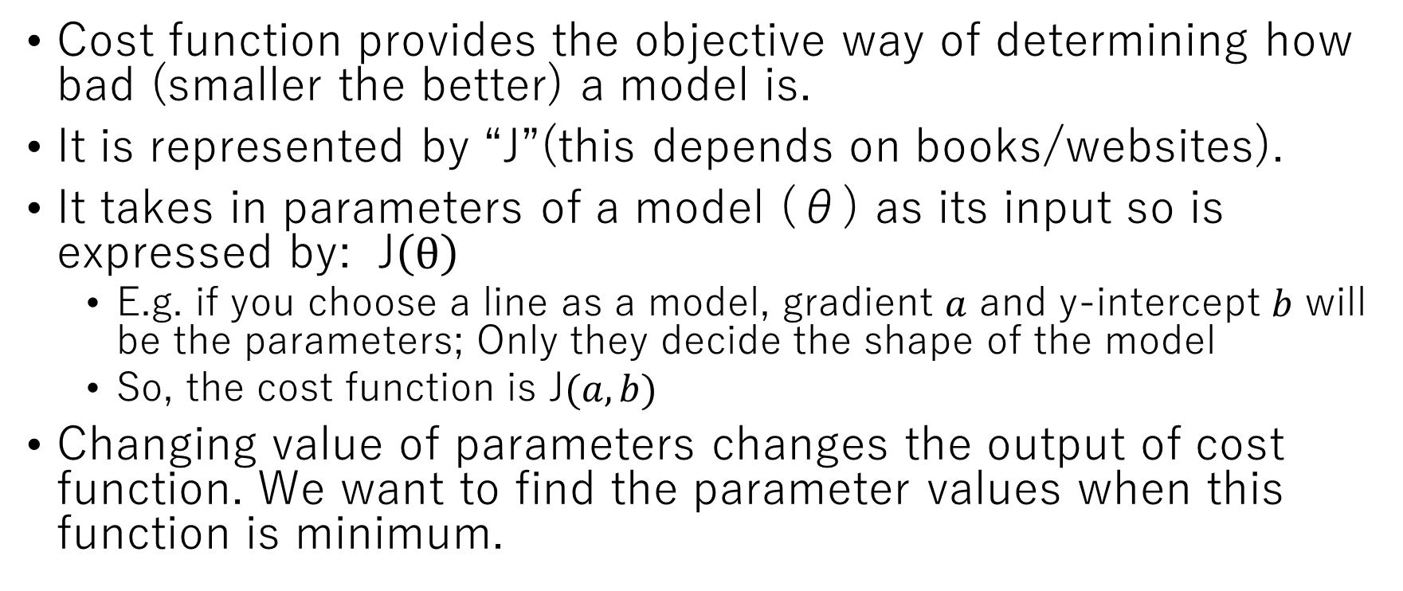
Cost Function2
Cost function provides the objective way of determining how bad (smaller the better) a model is.
It is represented by “J”(this depends on books/websites).
It takes in parameters of a model (θ) as its input so is expressed by: J$\left(θ\right)$
E.g. if you choose a line as a model, gradient $a$ and y-intercept $b$ will be the parameters; Only they decide the shape of the model
So, the cost function is J$(a, b)$
Changing value of parameters changes the output of cost function. We want to find the parameter values when this function is minimum.
Note: don’t get confused between a number of parameters and number of features. Usually, there are more parameters than features because there is/are bias (in linear regression the y-interept)

Slide 18
Cost Function 3: How to objectively define a bad fit?
Why not just calculate the difference between the actual y and predicted y and add them?
Two models on the same data
Diabetes Progression
the sum of the differences (the red lines) is definitely bigger in the right model. → because it’s big, it’s not a good model. This way, we can numerically compare models.
AND this is almost equivalent to the actual cost function that we will use.

Slide 19
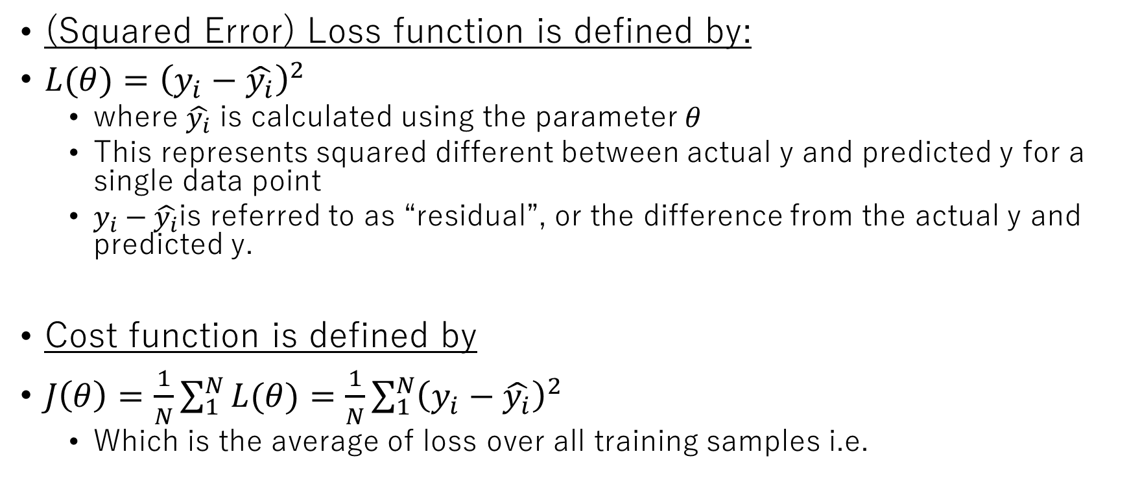
Cost Function 3
(Squared Error) Loss function is defined by:
$L(θ)={\left(y_{i}−\hat{y_{i}}\right)}^{2}$
where $\hat{y_{i}}$ is calculated using the parameter$θ$
This represents squared different between actual y and predicted y for a single data point
$y_{i}−\hat{y_{i}}$is referred to as “residual”, or the difference from the actual y and predicted y.
Cost function is defined by
$J\left(θ\right)=\frac{1}{N}\sum_{1}^{N}{L(θ)}=\frac{1}{N}\sum_{1}^{N}{{\left(y_{i}−\hat{y_{i}}\right)}^{2}}$
Which is the average of loss over all training samples i.e.

Slide 20
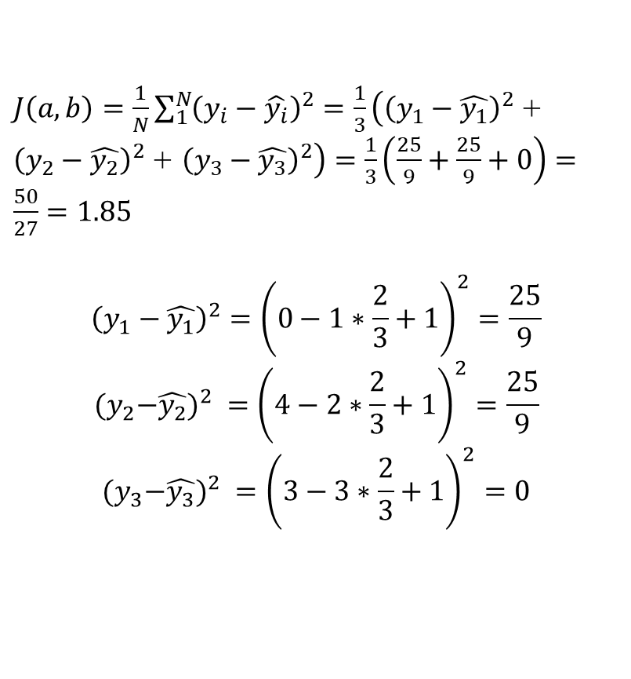
Cost Function 4 - example
a line with parameter values a=2/3 and b=1 is fitted to the data
(2, 4)
(3, 3)
$J\left(a, b\right)=\frac{1}{N}\sum_{1}^{N}{{\left(y_{i}−\hat{y_{i}}\right)}^{2}}=$ $\frac{1}{3}\left({\left(y_{1}−\hat{y_{1}}\right)}^{2} \text{+ }{\left(y_{2}−\hat{y_{2}}\right)}^{2} \text{+ }{\left(y_{3}−\hat{y_{3}}\right)}^{2}\right)=\frac{1}{3}\left(\frac{25}{9}+\frac{25}{9}+0\right)=\frac{50}{27}=1.85$
$${\left(y_{1}−\hat{y_{1}}\right)}^{2}={\left(0−1∗\frac{2}{3}+1\right)}^{2}=\frac{25}{9}$$
$${{(y}_{2}−\hat{y_{2}})}^{2} ={\left(4−2∗\frac{2}{3}+1\right)}^{2}=\frac{25}{9}$$
$${{(y}_{3}−\hat{y_{3}})}^{2} ={\left(3−3∗\frac{2}{3}+1\right)}^{2}=0$$
(3, 3*2/3 + 1)
y (label)
(2, 2*2/3 + 1=7/3)
(1, 1*2/3 + 1=5/3)
(1, 0)
x (feature)
Notes:
For each data point, calculate the difference between its y value and predicted y (by model) → the yellow ones
square each of them (to ignore +/-)
Calculate the sum
Divide by N (to get average)

Slide 21
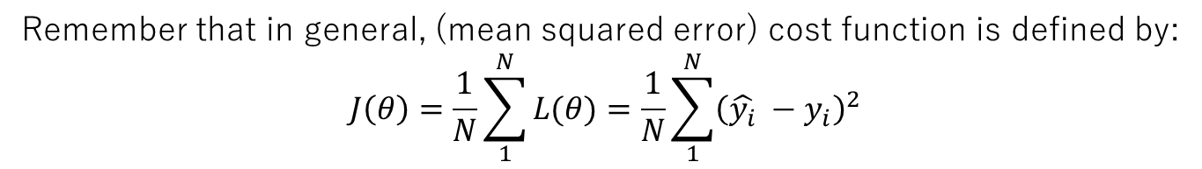

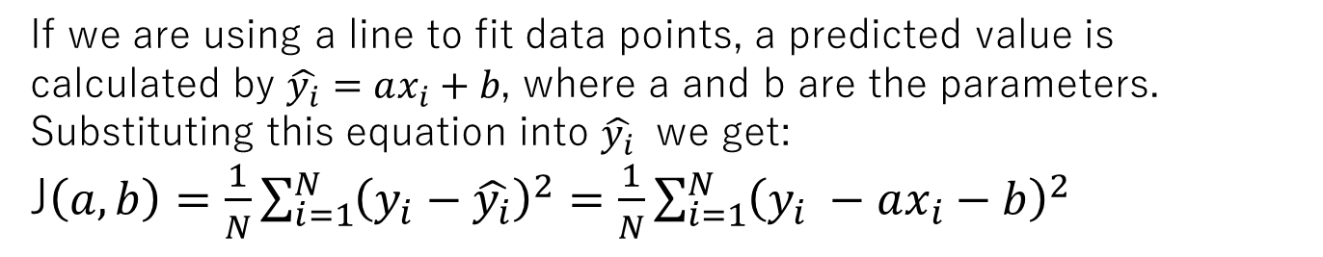
Cost Function 5 - for Simple Linear Reg
Remember that in general, (mean squared error) cost function is defined by:
$$J\left(θ\right)=\frac{1}{N}\sum_{1}^{N}{L(θ)}=\frac{1}{N}\sum_{1}^{N}{{\left(\hat{y_{i}} −y_{i}\right)}^{2}}$$
If we are using a line to fit data points, a predicted value is calculated by $\hat{y_{i}}=ax_{i}+b$, where a and b are the parameters.
Substituting this equation into $\hat{y_{i}}$ we get:
J$\left(a, b\right)=\frac{1}{N}\sum_{i=1}^{N}{{\left(y_{i}−\hat{y_{i}}\right)}^{2}}=\frac{1}{N}\sum_{i=1}^{N}{{\left(y_{i} −ax_{i}−b\right)}^{2}}$
Our task is to minimize this function. Formally:
$$\underset{a, b}{argmin}{\frac{1}{N}\sum_{i=1}^{N}{{\left(y_{i}−ax_{i}−b\right)}^{2}}}$$

Slide 22
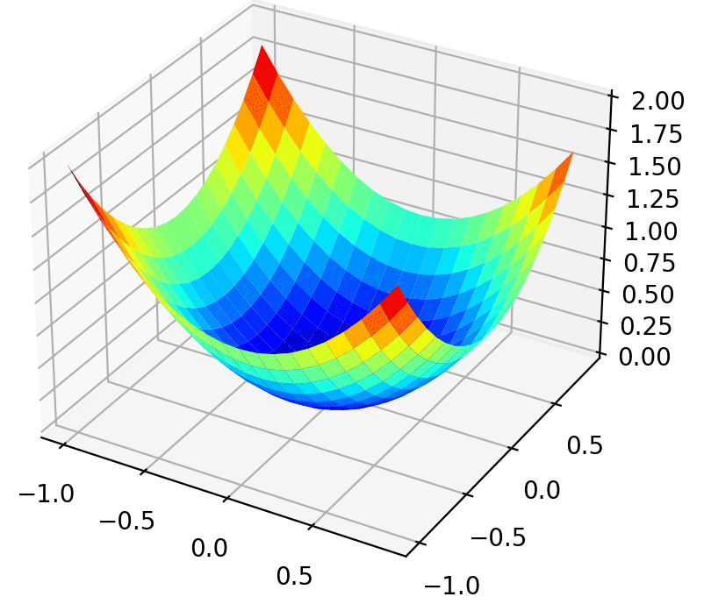
Typical Loss Function Visualization
For each set of parameters, there is a corresponding loss = for each line there is a loss.
The value of cost function
y-intercept
The weight of BMI

Slide 23
Choices of Loss functions
The loss function we discussed above actually is called squared error loss function because we squared the residual.
There are other loss functions too, Common ones are:
For Regression
Mean squared error
Mean absolute error
For classification
Logarithmic loss (used in logistic regression)
Cross entropy (used in neural network)

Slide 24
10 minutes break

Slide 25
Question: What is the value of loss function? Which is a better fit?
Parameter values: a=1/4, b=1
Parameter values: a=1, b=0
(3, 2)
(3, 2)
y (label)
y (label)
(1, 1)
(1, 1)
(2, 1)
(2, 1)
x (feature)
x (feature)

Slide 26
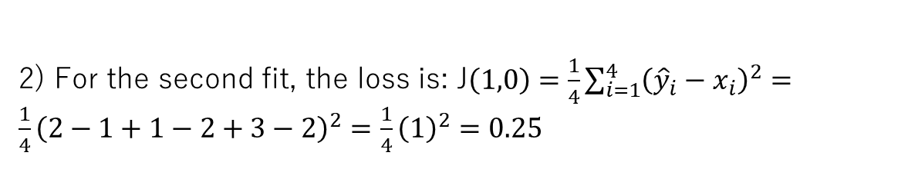
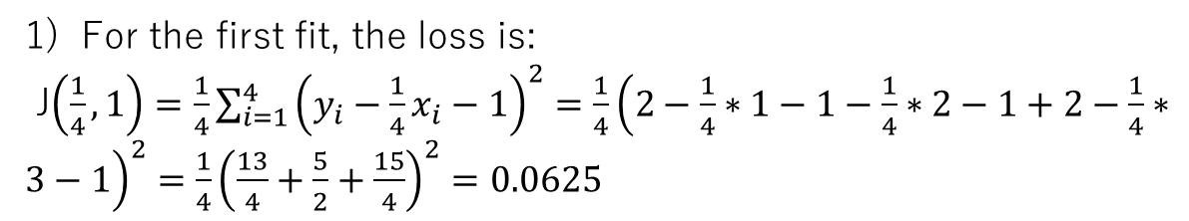
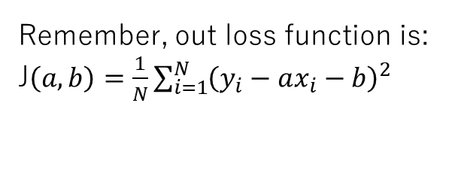
1 is better because...
Remember, out loss function is:
J$\left(a, b\right)=\frac{1}{N}\sum_{i=1}^{N}{{\left(y_{i}−ax_{i}−b\right)}^{2}}$
Data that we have are: {(1, 2), (2, 1), (3, 2)}
For the first fit, the loss is:
J$\left(\frac{1}{4},1\right)=\frac{1}{4}\sum_{i=1}^{4}{{\left(y_{i}−\frac{1}{4}x_{i}−1\right)}^{2}}=\frac{1}{4}{\left(2−\frac{1}{4}∗1−1−\frac{1}{4}∗2−1+2−\frac{1}{4}∗3−1\right)}^{2}={\frac{1}{4}\left(\frac{13}{4}+\frac{5}{2}+\frac{15}{4}\right)}^{2}=0.0625$
2) For the second fit, the loss is: J$\left(1,0\right)=\frac{1}{4}\sum_{i=1}^{4}{{\left({\hat{y}}_{i}−x_{i}\right)}^{2}}=\frac{1}{4}{\left(2−1+1−2+3−2\right)}^{2}={\frac{1}{4}\left(1\right)}^{2}=0.25$
=> Because the loss function is smaller the better, we can see that the first fit is better.

Slide 27
Mathematical Optimization

Slide 28
General Steps to create a ML algorithm
Prepare a Base Model
Define Cost(Objective) Function
Solve Mathematical Optimization Problem
Implement it

Slide 29
How do we minimize the loss function?
There is a mathematical branch called Mathematical Optimization, which is a dedicated field in optimizing different types of functions.
Most ML algorithms benefit from the knowledge of this branch.

Slide 30
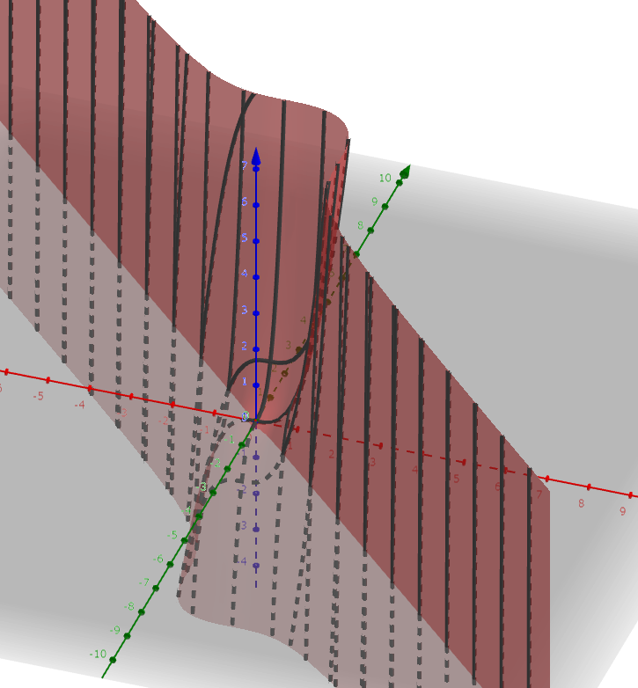
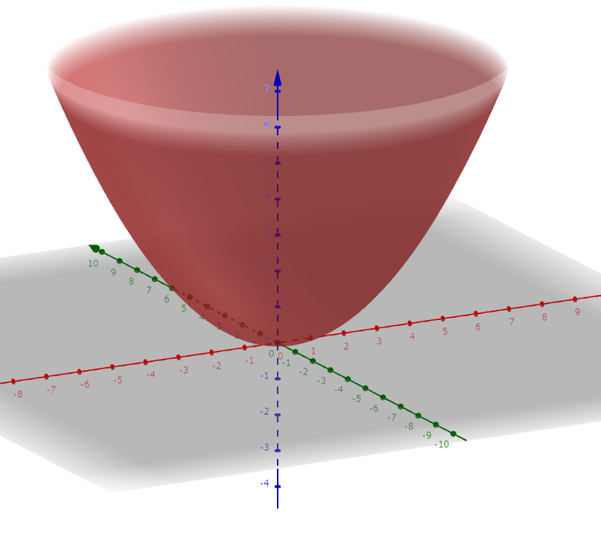
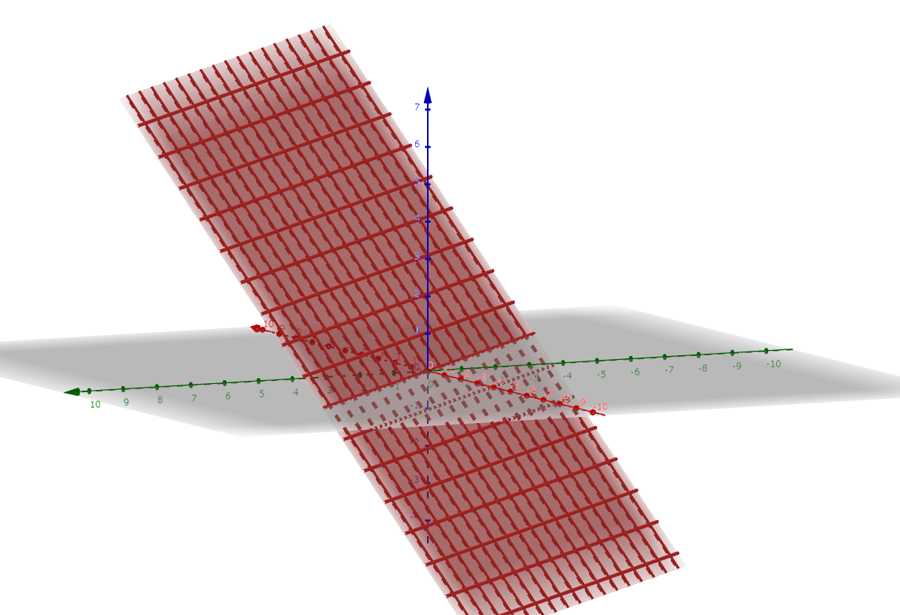
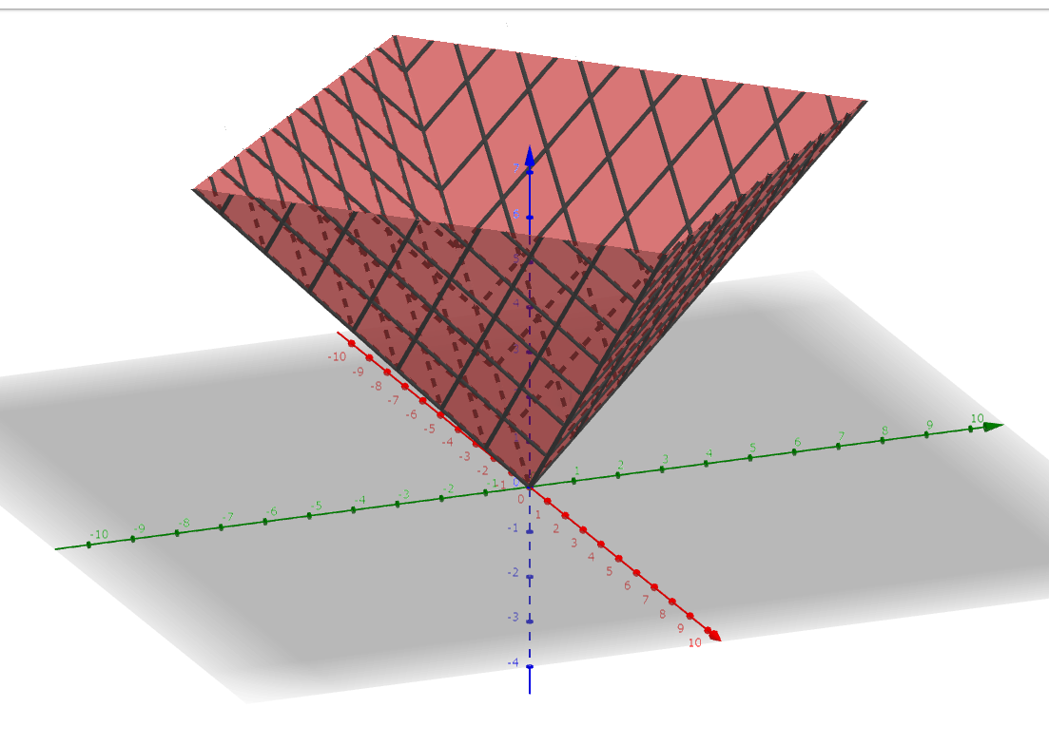
Question: What do you think the shape of a loss function look like?
1)
2)
3)
4)

Slide 31
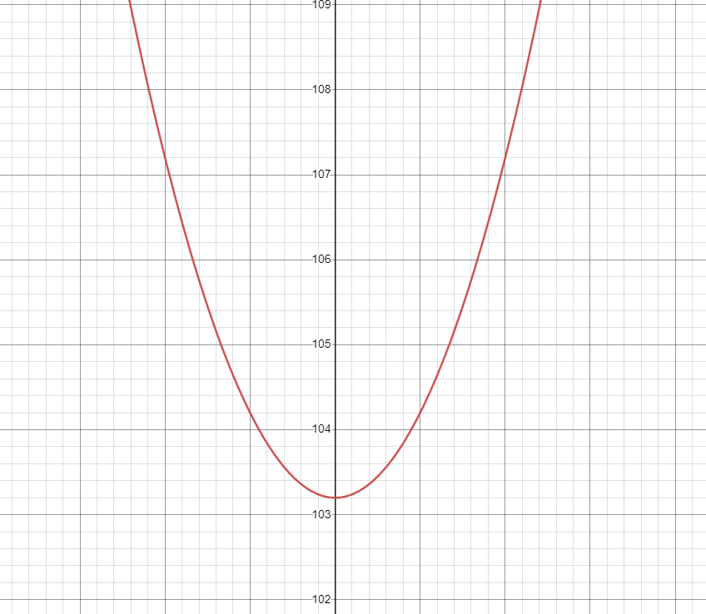
The answer is 1 or 4 because…
1)This line leads to a big loss because weight is too big
3)This line represents the relationship the best
loss
2)Bigger loss due to too big weight
1)Bigger loss due to too small weight (from optimum one)
Diabetes Progression
2)This line leads to a big loss because weight is too small
Value of a parameter (e.g. weight)
3)The smallest loss when a line represents the true data the best
BMI
Appropriately designed loss function should be a convex (concave up) function.
Notes:
The answer is 1 and 4. When we fit a line to a data using an appropriate loss function, there are usually three cases in terms of the value of loss function:
1) large value of loss function (which is unwanted) because weights are too big compared to optimum one,
2) large residuals because weights are too small compared to optimum one,
3) the smallest residual because the weights represent the true data the best.
The nature of the problem implies that a function should look like a cone where loss can be big in two ways and there is only one global minimum between them.

Slide 32
Different Optimization Types/Techniques
Mathematical optimization
Convex optimization
…
Analytical
Iterative
Gradient descent
Newton’s method
…
Momentum
Adagrad
…
But since it doesn’t take much time, we will implement this one too
Normal differentiation
A branch in mathematics
We are going to focus on this one today because it’s versatile and used everywhere

Slide 33


Analytical vs. Iterative
Analytical
Iterative
$$x_{i+1} =x_{i} −α∙2x$$
Getting closer to the local minimum one step-by-step, by using (in some form) the gradient at each point
Finds the local minimum by simply equating the gradient to 0
$$f\left(x\right)=x^{2}$$
$$\frac{df}{dx}=2x$$
$$0=2x⇒x=0$$
Both of them require the partial derivatives of the loss function; so we will first calculate them...

Slide 34
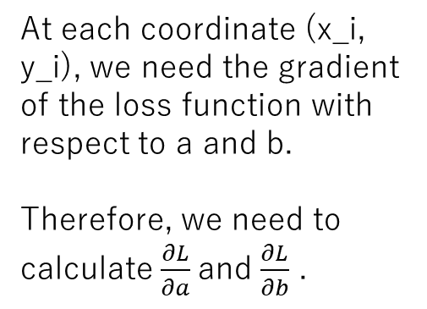
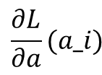
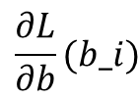
Our (actual) loss function looks something like this…
$$\frac{∂L}{∂a}(a_i)$$
$$\frac{∂L}{∂b}(b_i)$$
At each coordinate (x_i, y_i), we need the gradient of the loss function with respect to a and b.
Therefore, we need to calculate $\frac{∂L}{∂a}$and $\frac{∂L}{∂b}$ .
J(a, b) (Value of cost function
= average difference between true y and predicted y)
a
(wight for “bmi” feature)
b
(y-intercept)

Slide 35
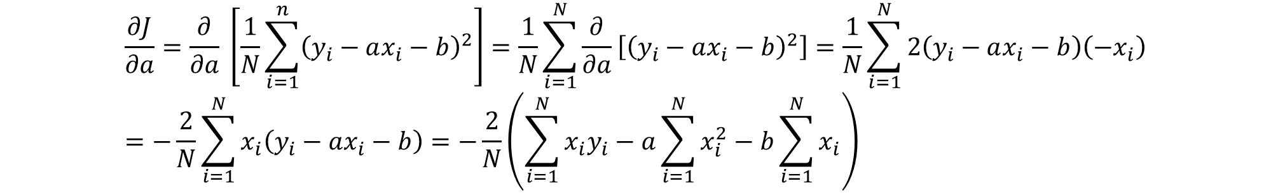

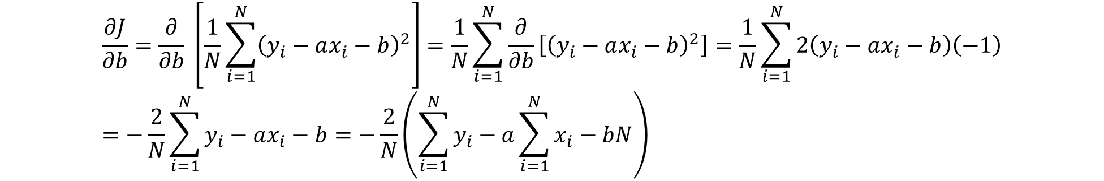
Partial Derivatives $\frac{∂J}{∂a}$ and $\frac{∂J}{∂b}$
$$\frac{∂J}{∂a}=\frac{∂}{∂a} \left[\frac{1}{N}\sum_{i=1}^{n}{{\left(y_{i}−ax_{i}−b\right)}^{2}}\right]=\frac{1}{N}\sum_{i=1}^{N}{\frac{∂}{∂a}\left[{\left(y_{i}−ax_{i}−b\right)}^{2}\right]}=\frac{1}{N}\sum_{i=1}^{N}{2\left(y_{i}−ax_{i}−b\right)\left(−x_{i}\right)}=−\frac{2}{N}\sum_{i=1}^{N}{x_{i}\left(y_{i}−ax_{i}−b\right)}=−\frac{2}{N}\left(\sum_{i=1}^{N}{x_{i}y_{i}}−a\sum_{i=1}^{N}{x_{i}^{2}}−b\sum_{i=1}^{N}{x_{i}}\right)$$
$$\frac{∂J}{∂b}=\frac{∂}{∂b} \left[\frac{1}{N}\sum_{i=1}^{N}{{\left(y_{i}−ax_{i}−b\right)}^{2}}\right]=\frac{1}{N}\sum_{i=1}^{N}{\frac{∂}{∂b}\left[{\left(y_{i}−ax_{i}−b\right)}^{2}\right]}=\frac{1}{N}\sum_{i=1}^{N}{2\left(y_{i}−ax_{i}−b\right)\left(−1\right)}=−\frac{2}{N}\sum_{i=1}^{N}{y_{i}−ax_{i}−b}=−\frac{2}{N}\left(\sum_{i=1}^{N}{y_{i}}−a\sum_{i=1}^{N}{x_{i}}−bN\right)$$

Slide 36


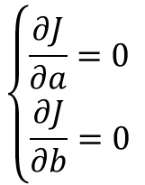

Let’s first use the partial derivatives to analytically fit the model to data
To analytically find the local minimum, we need to equate all the partial derivatives to 0 and solve systems of linear equations.
$$\frac{∂J}{∂a}=0$$
$$−\frac{1}{N}\left(\sum_{i=1}^{N}{x_{i}y_{i}}−a\sum_{i=1}^{N}{x_{i}^{2}}−b\sum_{i=1}^{N}{x_{i}}\right)=0$$
$$\sum_{i=1}^{N}{x_{i}y_{i}}−a\sum_{i=1}^{N}{x_{i}^{2}}−b\sum_{i=1}^{N}{x_{i}} =0$$
$$\sum_{i=1}^{N}{x_{i}y_{i}}−a\sum_{i=1}^{N}{x_{i}^{2}}−\frac{1}{N}\left(\sum_{i=1}^{N}{y_{i}}−a\sum_{i=1}^{N}{x_{i}}\right)\sum_{i=1}^{N}{x_{i}} =0$$
$$\sum_{i=1}^{N}{x_{i}y_{i}}−a\sum_{i=1}^{N}{x_{i}^{2}}−\frac{1}{N}\sum_{i=1}^{N}{x_{i}}\sum_{i=1}^{N}{y_{i}}+\frac{a}{N}\sum_{i=1}^{N}{x_{i}}\sum_{i=1}^{N}{x_{i}}=0$$
$a\left(−\sum_{i=1}^{N}{x_{i}^{2}}+\frac{1}{N}\sum_{i=1}^{N}{x_{i}}\sum_{i=1}^{N}{x_{i}}\right)=−\sum_{i=1}^{N}{x_{i}y_{i}}$ $+\frac{1}{N}\sum_{i=1}^{N}{x_{i}}\sum_{i=1}^{N}{y_{i}}$
$$a=\frac{−\sum_{i=1}^{N}{x_{i}y_{i}} +\frac{1}{N}\sum_{i=1}^{N}{x_{i}}\sum_{i=1}^{N}{y_{i}}}{−\sum_{i=1}^{N}{x_{i}^{2}}+\frac{1}{N}\sum_{i=1}^{N}{x_{i}}\sum_{i=1}^{N}{x_{i}}}$$
$$b=\frac{1}{N}\left(\sum_{i=1}^{N}{y_{i}}−\frac{−\sum_{i=1}^{N}{x_{i}y_{i}} +\frac{1}{N}\sum_{i=1}^{N}{x_{i}}\sum_{i=1}^{N}{y_{i}}}{−\sum_{i=1}^{N}{x_{i}^{2}}+\frac{1}{N}\sum_{i=1}^{N}{x_{i}}\sum_{i=1}^{N}{x_{i}}}\sum_{i=1}^{N}{x_{i}}\right)$$
$$\left\{\begin{aligned}\frac{∂J}{∂a}=0 \\ \frac{∂J}{∂b}=0 \end{aligned}\right.$$
$$\frac{∂J}{∂b}=0$$
$$−\frac{2}{N}\left(\sum_{i=1}^{N}{y_{i}}−a\sum_{i=1}^{N}{x_{i}}−bN\right)=0$$
$$\sum_{i=1}^{N}{y_{i}}−a\sum_{i=1}^{N}{x_{i}}−bN=0$$
$$b=\frac{1}{N}\left(\sum_{i=1}^{N}{y_{i}}−a\sum_{i=1}^{N}{x_{i}}\right)$$

Slide 37
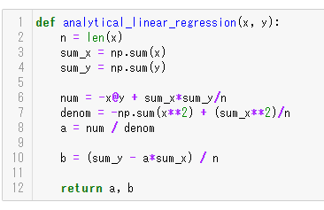
Code Along: Let’s implement the SLR with analytical approach

Slide 38
Gradient Descent and Iterative Optimization

Slide 39

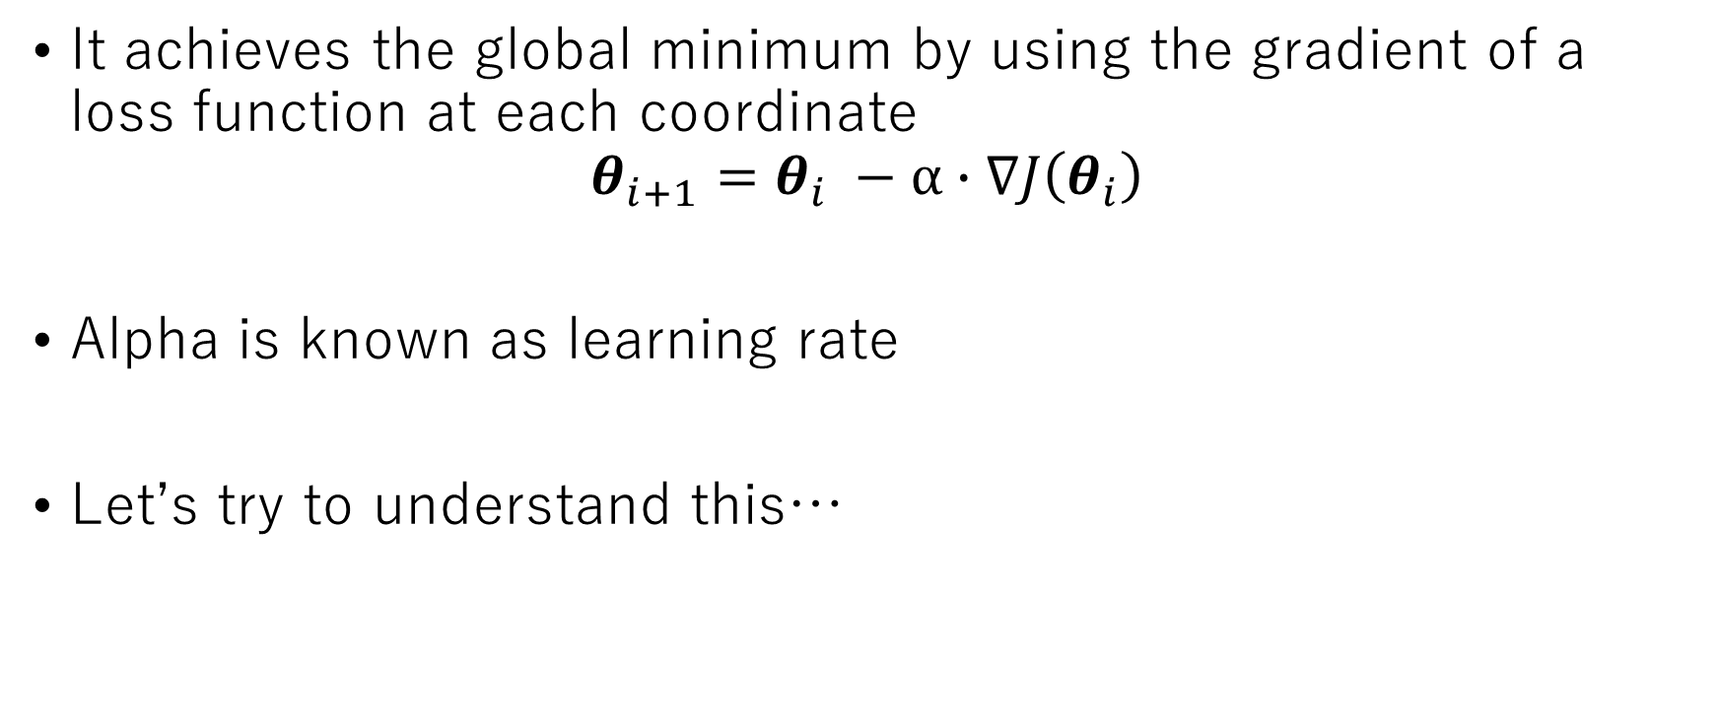
Iterative Approach - Gradient Descent
It achieves the global minimum by using the gradient of a loss function at each coordinate
$$θ_{i+1}=θ_{i} −α∙∇J\left(θ_{i}\right)$$
Alpha is known as learning rate
Let’s try to understand this…
Grad = Partial derivatives of all parameters. it looks something like this:
$$\left[\begin{matrix}\frac{dJ}{dθ_{1}} \\ ⋮ \\ \frac{dJ}{dθ_{n}}\end{matrix}\right]$$

Slide 40

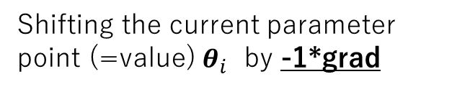
Understanding Gradient Descent 1
if a function is convex, the grad at each point is directed towards the opposite direction of global minimum
→ if you multiply the grad by -1, and use it to shift the position of parameters, the loss point should move to a new location where the cost function is smaller and closer to the global minimum
Grad this way
Global min this way
$$θ_{i+1}=θ_{i} −α∙∇J\left(θ_{i}\right)$$
Shifting the current parameter point (=value) $θ_{i}$ by -1*grad

Slide 41
Understanding Gradient Descent 2
Magnitude of gradient gets smaller as the point gets closer to the global minimum. → the amount of “shift” for the point gets smaller too.
Why is the algorithm designed this way?
As the point gets closer to the global minimum, the algorithm must be more careful to not miss the local minimum easily.
A famous analogy - hiking: when you go down a mountain, initially you roughly decide which direction to go. As you get closer to the foot of the mountain, you need to be more careful about which direction to move based on where the starting point was.
grad

Slide 42
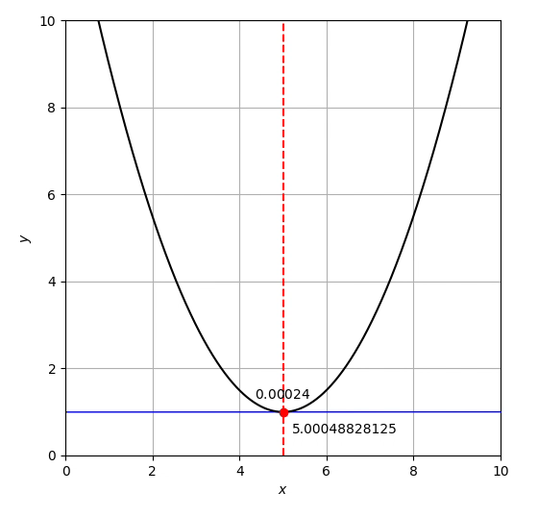
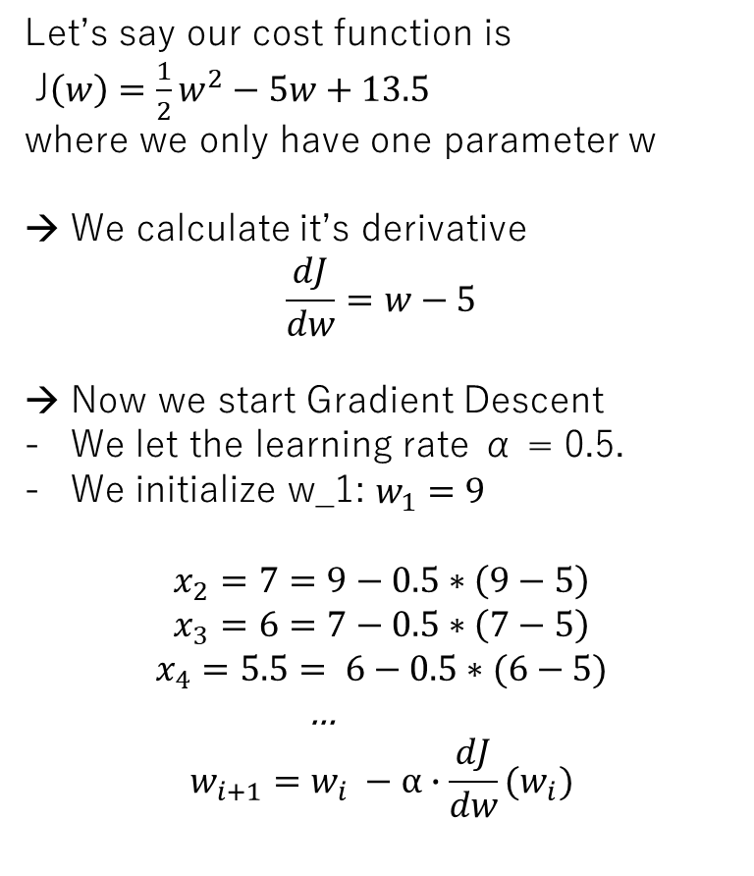
Example: only one parameter
From https://chokkan.github.io/mlnote/regression/04sgd.html
Let’s say our cost function is
J$\left(w\right)={\frac{1}{2}w}^{2}−5w+13.5$
where we only have one parameter w
→ We calculate it’s derivative
$$\frac{dJ}{dw}=w−5$$
Now we start Gradient Descent
We let the learning rate α = 0.5.
We initialize w_1: $w_{1}=9$
$$x_{2}=7=9−0.5∗\left(9−5\right)$$
$$x_{3}=6=7−0.5∗\left(7−5\right)$$
$$x_{4}=5.5= 6−0.5∗(6−5)$$
…
$$w_{i+1}=w_{i} −α∙\frac{dJ}{dw}(w_{i})$$

Slide 43
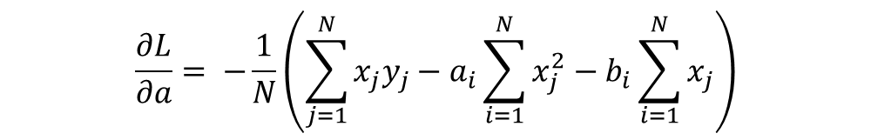


GD Equation for Simple Linear Reg
$$θ_{i+1}=θ_{i} −α∙∇J\left(θ_{i}\right)$$
$$=\left(\begin{matrix}a_{i} \\ b_{i}\end{matrix}\right)−α∙\left(\begin{matrix}\frac{∂L}{∂a} \\ \frac{∂L}{∂b}\end{matrix}\right)$$
$$\frac{∂L}{∂a}= −\frac{1}{N}\left(\sum_{j=1}^{N}{x_{j}y_{j}}−a_{i}\sum_{i=1}^{N}{x_{j}^{2}}−b_{i}\sum_{i=1}^{N}{x_{j}}\right)$$
Substitute into
$$\frac{∂L}{∂b}=−\frac{2}{N}\left(\sum_{j=1}^{N}{y_{j}}−a_{i}\sum_{j=1}^{N}{x_{j}}−b_{i}N\right)$$

Slide 44
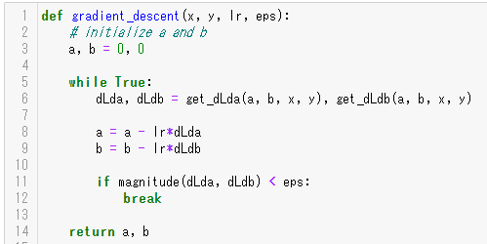
Code Along: Let’s implement it!

Slide 45
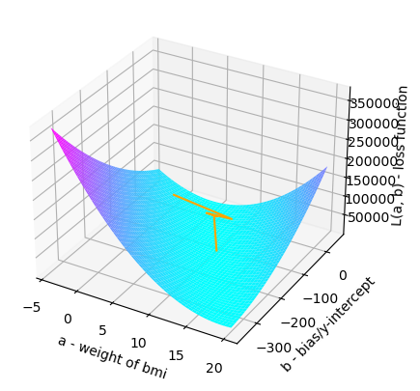
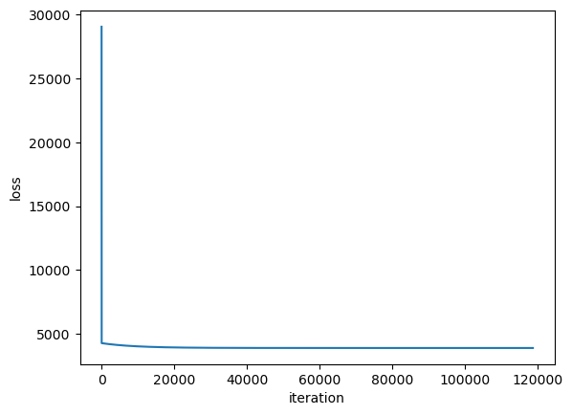



Visualizing the actual iterative learning process
Visualizing the loss
Value of Cost Function as iteration proceeds
Starting coordinate = (0, 0, z)
Ending coordinate = global min
→ most of the optimization occurs in the earlier iterations

Slide 46
Hyperparameters of GD
There are two hyperparameters (parameters that you need to determine by yourself by trial and error) in GD.
learning rate: it controls how quickly you want to move to get to the minima. In the above example, we choose 0.001.
Too big → lacks precision
Too small → more likely the iteration trapped on a saddle point; learning process takes longer time
the epsilon: It controls when to stop the iterative process of GD. It is defined by the magnitude of gradient. In the above example we chose it as 0.1.
Too big → lacks precision
Too small → learning process takes longer time (learning process might not finish forever; as counter-measure, sometimes we make another hyperparameter for the maximum number of iterations)

Slide 47
Advantage of using iterative approach/GD
Why iterative approach preferred to analytical one?
Three problems in analytical approach:
Time Complexity is too high, because it always require calculation of inverse matrix. Calculation of inverse matrix for n*n matrix requires O(n^3).
Space Complexity is high and intolerable when there are millions of data points (=observations). O(n^2) required.
Many loss functions aren’t simple and so cannot be solved analytically (e.g. loss function for neural network).
Notes:
At first glance, it might seem that using iterative approach doesn’t make sense because it seems slow (with all the updates)
However, in many cases, iterative approach is faster. This is because the analytical approach always require an inverse matrix.
If you’ve taken MAT1841, I think you have experience in calculating inverse matrix by hands and feeling it so annoying. Even with the fastest inverse matrix algorithm, it’s still O(n^3) to solve n*n matrix.
Also, the analytical approach requires O(n^2) space complexity, which is huge, especially when you have millions of data points.

Slide 48
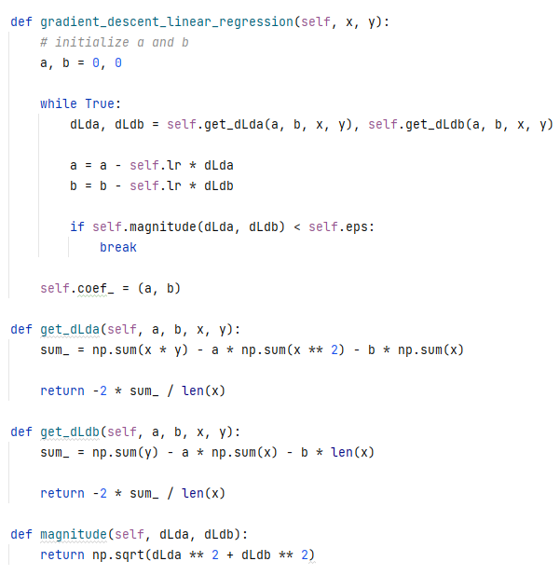
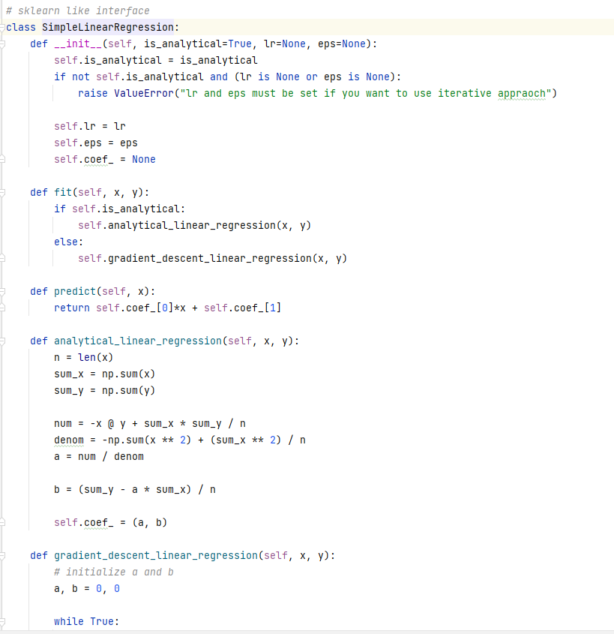
Code Along: Let’s implement the SLR as a Class (if we have time)

Slide 49
Summary

Slide 50
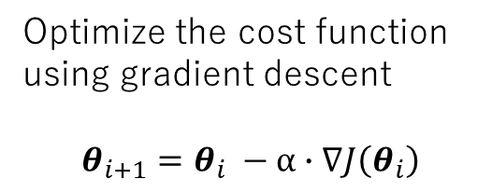

General Steps to create a ML algorithm
Prepare a Base Model
Define Cost(Objective) Function
Solve Mathematical Optimization Problem
Implement it
Design a cost function using the prepared model
$$J\left(θ\right)=\frac{1}{N}\sum_{1}^{N}{{\left(y_{i}−\hat{y_{i}}\right)}^{2}}$$
Choose a base model that suits that complexity of data
Optimize the cost function using gradient descent
$$θ_{i+1}=θ_{i} −α∙∇J\left(θ_{i}\right)$$

Slide 51
Something
Something you can try:
implementing logistic regression from scratch (make it inherit from the regression base class)
Implementing Ridge regression from scratch

Slide 52
What is Loss Function? Why we need it?
We ASSUME that the data points represent the TRUE relationship between X and y
We want our model (i.e. a line or any other functions) to represent the TRUTH.
Even with a line, there are varieties of them → Visually, we might be able to tell that some of them represents the true relationship better
However, we need a number that objectively and technically ranks each line to find the best line
→ Need for Loss function

Slide 53
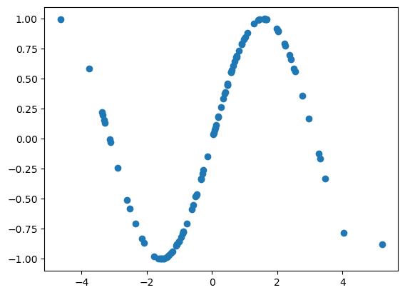
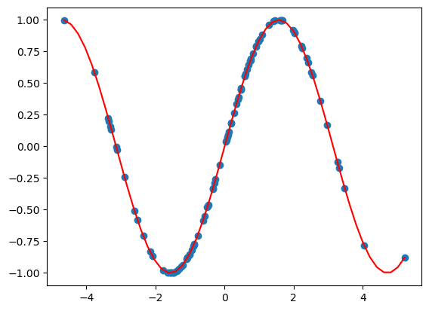
Same with more complex algorithms, but they can fit to more complex data
Models (red line/curve) fit to the data points (blue dots)
Decision Tree
Neural Network
We are trying to achieve a function (a line/curve, etc) that best describe of the true relationship between features (predictors) and a label (target).

Slide 54
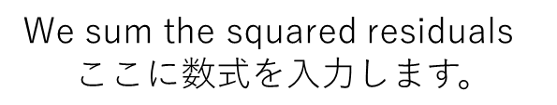
Cost Function 3 - example
Parameter values: a=1/4, b=1
(2, 4)
We sum the squared residuals
(3, 3)
y (label)
(1, 0)
x (feature)

Slide 55
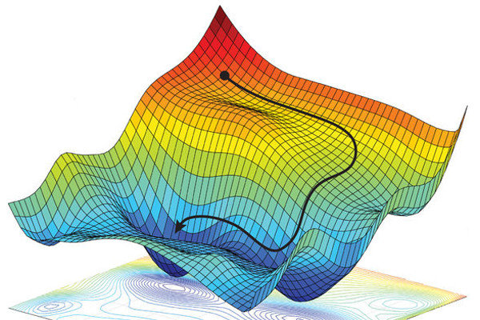
https://stats.stackexchange.com/questions/481746/is-this-graph-of-loss-function-or-input-data-distribution

